Slide 1
B . M . S
BANK MANAGEMENT SYSTEM
Designed by : Fopa Y. Amadou Olabi [ 154446 ]

Slide 2
OUTLOOK ON THE PROJECT
A Bank is a commercial or state institution that provides financial services, including issuing money in form of coins, banknotes or debit cards, receiving deposits of money and processing transactions.
In today’s world, Banks are going through some sudden and abrupt changes in the structure, maintenance and modification, handling, leveling inside every system.
There are many errors and drawbacks without use of computer programming and applications.
One of the main issues in your days, is providing 100% security to the customer by securing his money in a computerized system.

Slide 3
PURPOSE OF BANK MANAGEMENT SYSTEM
The project that we have undertaken aims to develop a banking system that is clean, user-friendly and multi-functional.
Development of this application includes a number of fields such that user feels comfortable and the system appears as dynamic to him.
The Bank Management System is an application for maintaining a person’s account in a bank.
The system provides the access to the costumer to create an account, deposit/withdraw the cash from his account.
The bank administration and staff member’s are working to provide the best experience ever for the user by monitoring his transactions and account activities.

Slide 4
BENEFITS OF BANK MANAGEMENT SYSTEM
It creates a user friendly environment, where a normal user can access through all the benefits of the system.
It provides security from unauthorized access, only admin or authorized users are granted access to the system.
It increases efficiency and saves the time.
No any danger and obstacles from external entities.
Easy access of saved data inside the system.
Complex Banking operations and Transaction operations are efficiently handled by the system.
It is highly secured and less time consuming; hence time wastage can be avoided
Up to date records of the customers are maintained by the authority.

Slide 5
STRUCTURE OF THE PROJECT
Welcome Screen
CLIENT
STAFF
ADMIN.
BMS DB
BMS DB
BMS DB
Activate Account
Create Staff/Admin.
Delete (Clt, Staff, Ad.)
Check BMS Wallet
View User’s Activities
View & Flush Feed’s
View Transactions
Display All Accounts
Search (Clt, Staff, Ad.)
Give Updates
Balance
Withdraw
Transfer
History
Edit PIN
Info Pool
Feedback
Create Client
Deposit Money
Client History
Search Client
Info Pool
Request PIN Reset
1
0
Note: This Project was done using Double-way Linked List

Slide 6
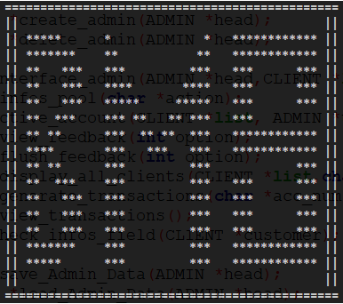
Thanks !!!
”Necessity is the mother of invention”

